Slide 1
Green University of Bangladesh
Department of Computer Science & Engineering
Subject: Compiler
Course Code: CSE-305
Our Presentation topic : Introduction to Compiler
Submitted To:
Name : Atik Ahamed
Designation : Lecturer
Department : CSE
Green university of Bangladesh
Submitted by:
Name : Md.Nur A Neouse
ID :193002093
Name : Nazifa Alam Nowrin
ID :193002103
Name : Jakirul Islam
ID :193002101

Slide 2
Contents
Definition of compiler
What do compiler do
Phases of compiler
Types of compiler
Advantages of compiler

Slide 3
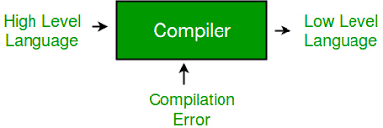
Definition of compiler
In computing, a compiler is a computer program that translates computer code written in one programming language into another language. The name "compiler" is primarily used for programs that translate source code from a high-level programming language to a lower level language to create an executable program

Slide 4
What do compilers do?
Compilers generate 3 types of code:
Pure machine code
Augmented machine code
Virtual machine code

Slide 5
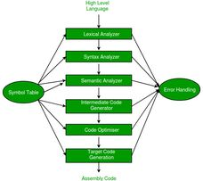
Phases of a Compiler :

Slide 6
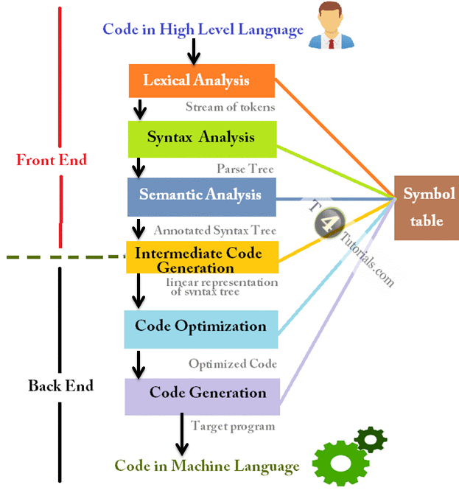
Compiler phases :

Slide 7
Types of compiler :
Negative code compiler
Cross compiler
Source to source compiler
One pass compiler
Threaded code compiler
Incremental compiler
Source compiler

Slide 8
Advantages of compiler :
Compilers have several advantages:
Compiled programs run quickly, since they have already been translated.
A compiled program can be supplied as an executable file. An executable file is a file that is ready to run. ...
Compilers optimise code. Optimised code can run quicker and take up less memory space.

Slide 9
Thank You

